Slide 1

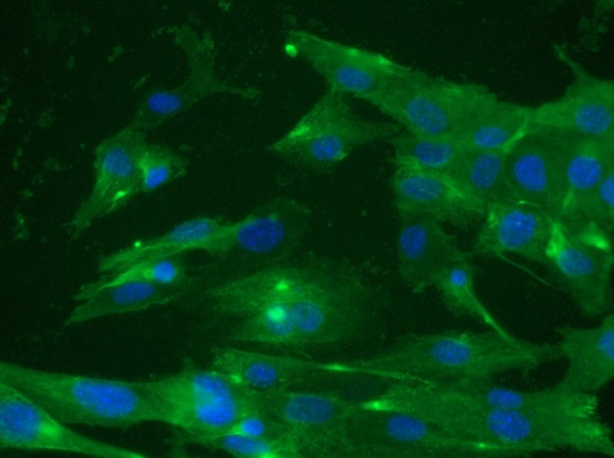
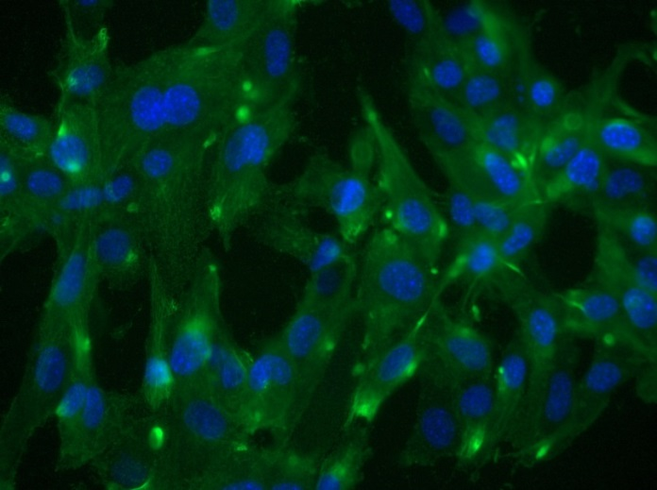
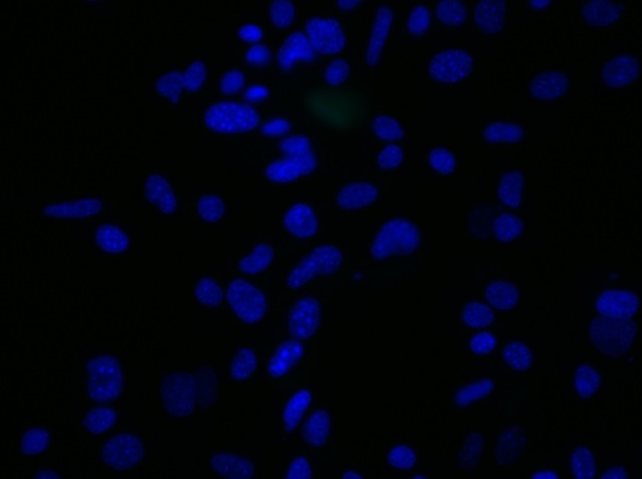
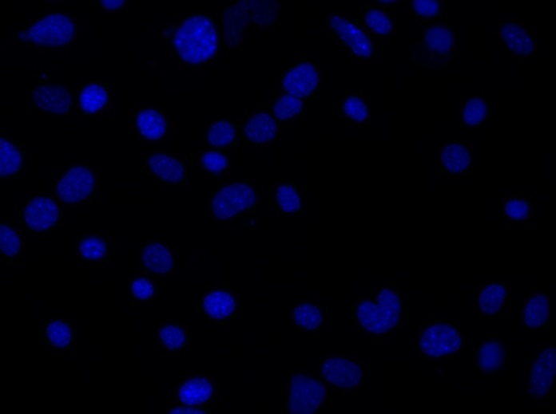
Reliatech GmbH
Rat anti-mouse VEGFR2/Flk-1
(Cat# 103-M32; SnoMec)
Immunofluorescence staining of mouse VEGFR-2/Flk-1 (#103-M32) in primary mouse endothelial cells (SnoMec) using a monoclonal antibody directed against the extracellualr domain of Flk-1.
As secondary antibody goat anti-rat ALEXA Flour 488 (Dianova; 1:400) was used.
[IF_mEC1407-02]
.
rat anti-mouse Flk1
rat anti-mouse Flk1
Control (goat anti-rat IgG ALEXA Flour 488; 1:400)
http://www.reliatech.de / orders@reliatech.de

